Slide 1

19ECE204 DIGITAL ELECTRONICS AND SYSTEMS Lecture 3 & 4

Slide 2
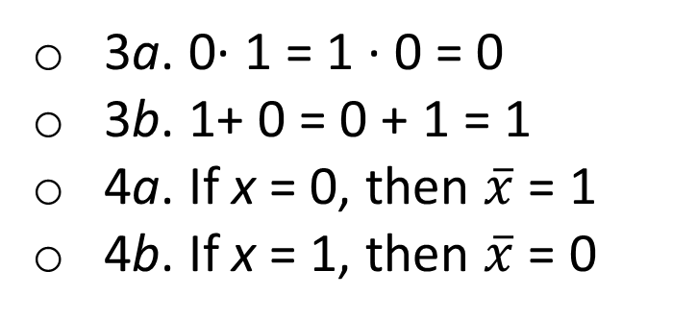
Boolean Algebra - Axioms
In 1849, George Boole published an algebraic description scheme for logical thought and reasoning processes.
In the late 1930s Claude Shannon showed that Boolean algebra provides an effective means of describing circuits built with switches.
This algebra in turn became a powerful tool to express logic circuits.
Assumptions or Axioms of Boolean Algebra
1a. 0· 0 = 0
1b. 1+ 1 = 1
2a. 1· 1 = 1
2b. 0+ 0 = 0
3a. 0· 1 = 1 · 0 = 0
3b. 1+ 0 = 0 + 1 = 1
4a. If x = 0, then $\overline{x}$ = 1
4b. If x = 1, then $\overline{x}$ = 0

Slide 3
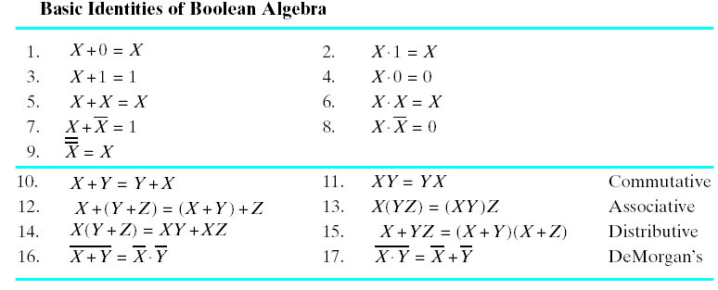
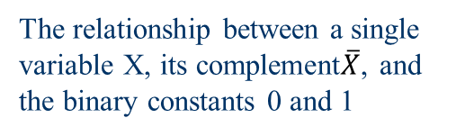
Basic Identities or Theorems of Boolean Algebra
If X is a Boolean variable then,
The relationship between a single variable X, its complement$\overline{X}$, and the binary constants 0 and 1

Slide 4
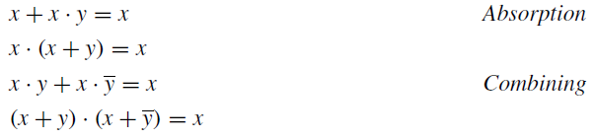
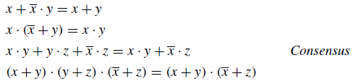
Cntd..
These identities can be proved by using the axioms of Boolean algebra, truth table or Venn Diagram

Slide 5
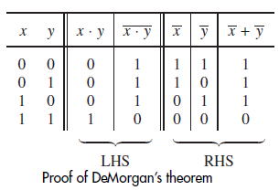
Proof of DeMorgan’s theorem & Duality
Given a logic expression, its dual is obtained by:
replacing all + operators with · operators, and vice versa, and
by replacing all 0s with 1s, and vice versa.
Duality - The dual of any true statement in Boolean algebra is also a true statement.

Slide 6


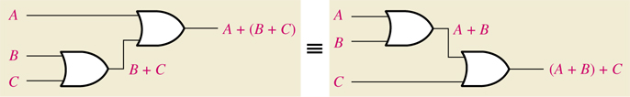
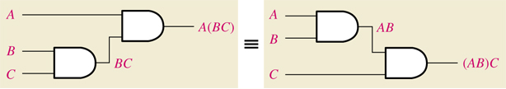
Laws of Boolean Algebra with gates
Commutative Law: the order of literals or variables does not matter
A + B = B + A A B = B A
Associative Law: the grouping of literals does not matter
A + (B + C) = (A + B) + C =A+B+C A(BC) = (AB)C =ABC

Slide 7
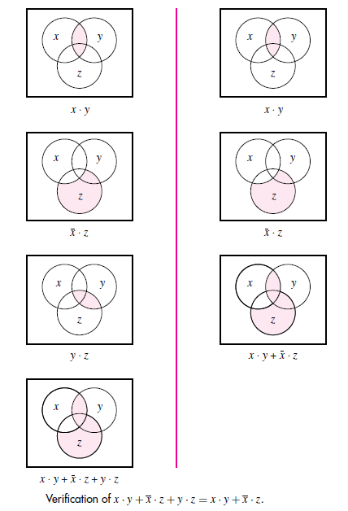
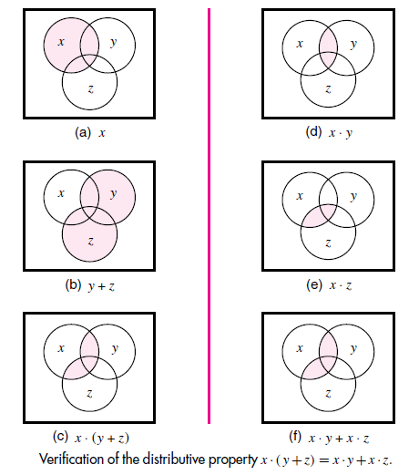
Venn Diagram

Slide 8
Precedence of Operators & Other Notations
In the absence of parentheses, operations in a logic expression must be performed in the order: NOT, AND, and then OR.
Also, the ‘∧’ symbol can denote the AND operation, and the ‘∨’ symbol can denote the OR operation.
x₁ ∧ x₂ => x₁ · x₂
x₁ ∨ x₂ => x₁ +x₂
The OR and AND operations are also called the logical sum and product operations. Hence,
x₁ +x₂ is the logical sum and
x₁ · x₂ is the logical product.
Also can be called simply “product” and “sum.”
Thus, x₁ · x₂ · x₃ + x₁ · x₄ + x₂ · x₃ · x₄ is a sum of three product terms
(x₁ + x₃) · (x₁ + x₃) · (x₂ + x₃ + x₄) is a product of three sum terms.
Similarly, x₁ · x₂ + x₁ · x₃ = x₁x₂+x₁x₃

Slide 9
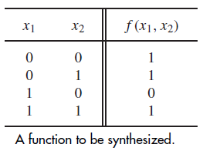
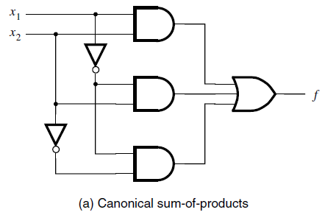
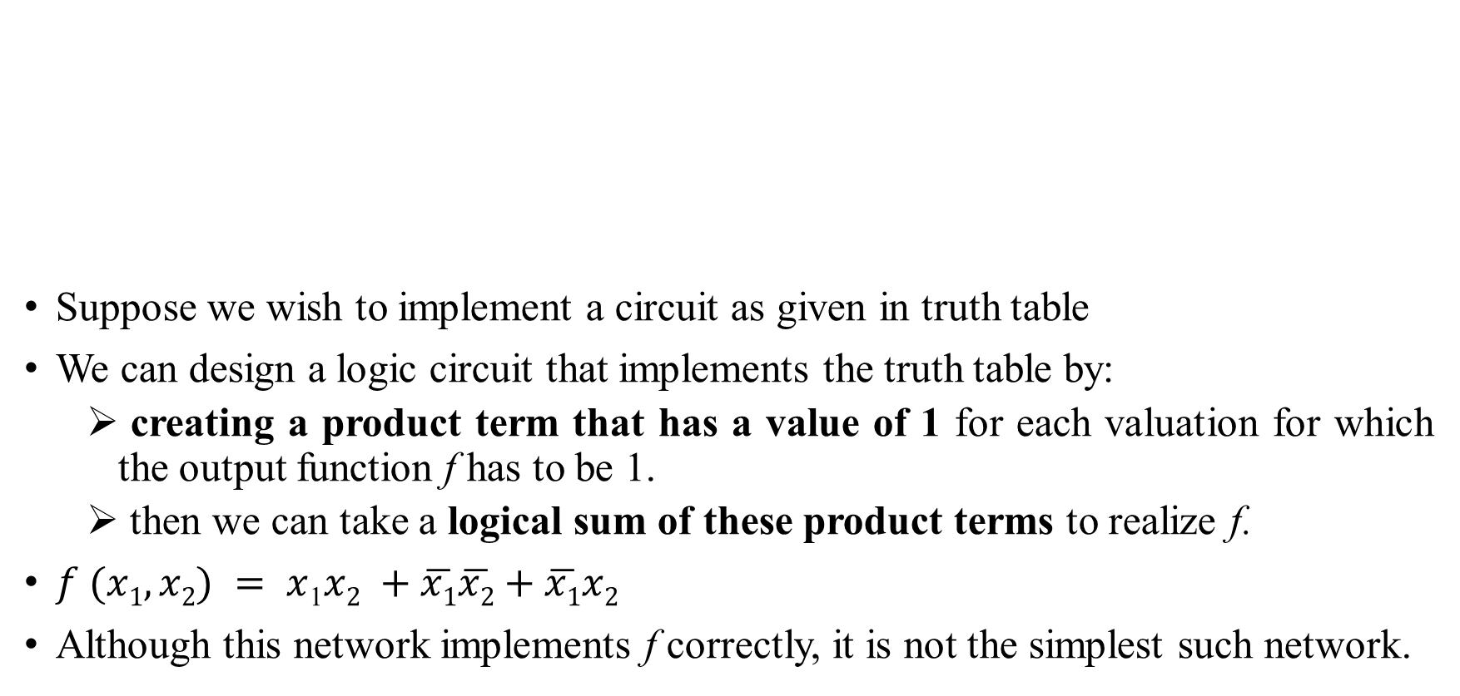
Synthesis Using AND, OR, and NOT Gates
Suppose we wish to implement a circuit as given in truth table
We can design a logic circuit that implements the truth table by:
creating a product term that has a value of 1 for each valuation for which the output function f has to be 1.
then we can take a logical sum of these product terms to realize f.
$f (x1, x2) = x$₁$x2 +\overline{x1}\overline{x2}+\overline{x1}x2$
Although this network implements f correctly, it is not the simplest such network.

Slide 10

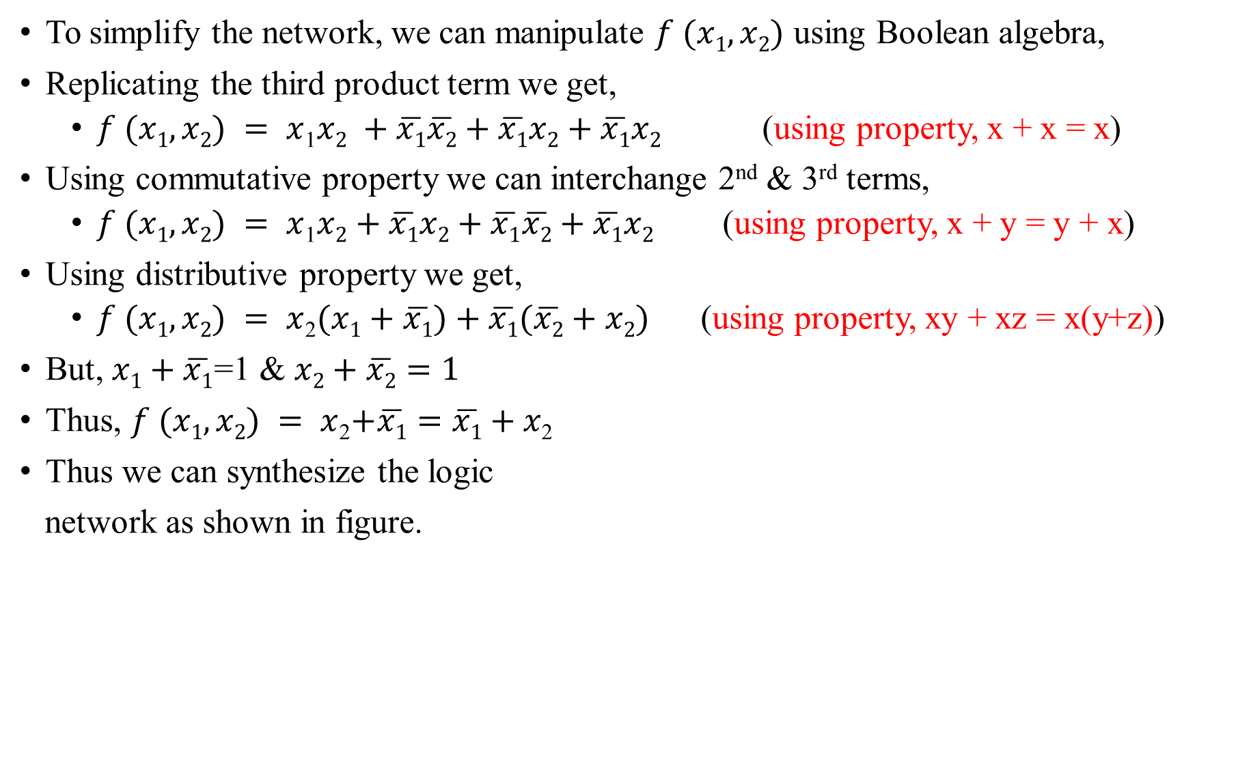
Contd.
To simplify the network, we can manipulate $f (x1, x2)$ using Boolean algebra,
Replicating the third product term we get,
$f (x1, x2) = x$₁$x2 +\overline{x1}\overline{x2}+\overline{x1}x2+\overline{x1}x2$ (using property, x + x = x)
Using commutative property we can interchange 2nd & 3rd terms,
$f (x1, x2) = x$₁$x2+\overline{x1}x2+\overline{x1}\overline{x2}+\overline{x1}x2$ (using property, x + y = y + x)
Using distributive property we get,
$f (x1, x2) = x$₂$(x1+\overline{x1})+\overline{x1}(\overline{x2}+x2)$ (using property, xy + xz = x(y+z))
But, $x1+\overline{x1}$=1 & $x2+\overline{x2}=1$
Thus, $f (x1, x2) = x$₂$+\overline{x1}=\overline{x1}+x\text{2}$
Thus we can synthesize the logic
network as shown in figure.

Slide 11
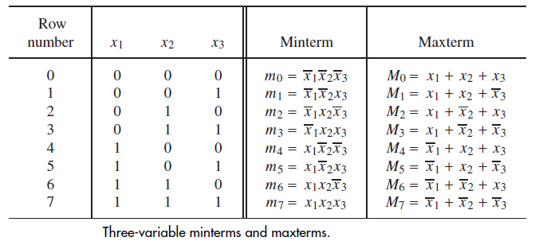
Sum-of-Products and Product-of-Sums Forms
For a function of n variables, a product term in which each of the n variables appears once is called a minterm
A function f can be represented as a sum of minterms, by ANDing each minterm with the value of f for the corresponding valuation of input variables.

Slide 12

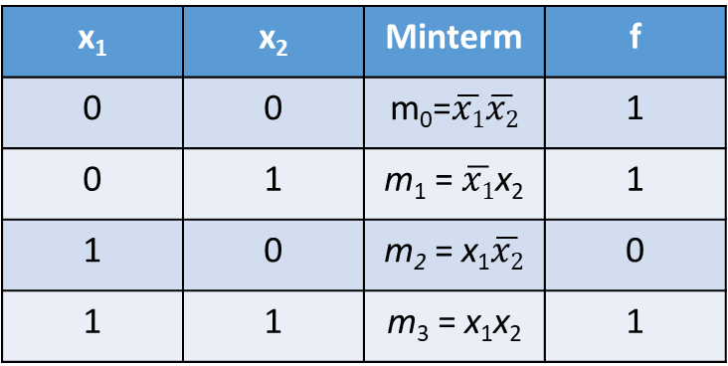
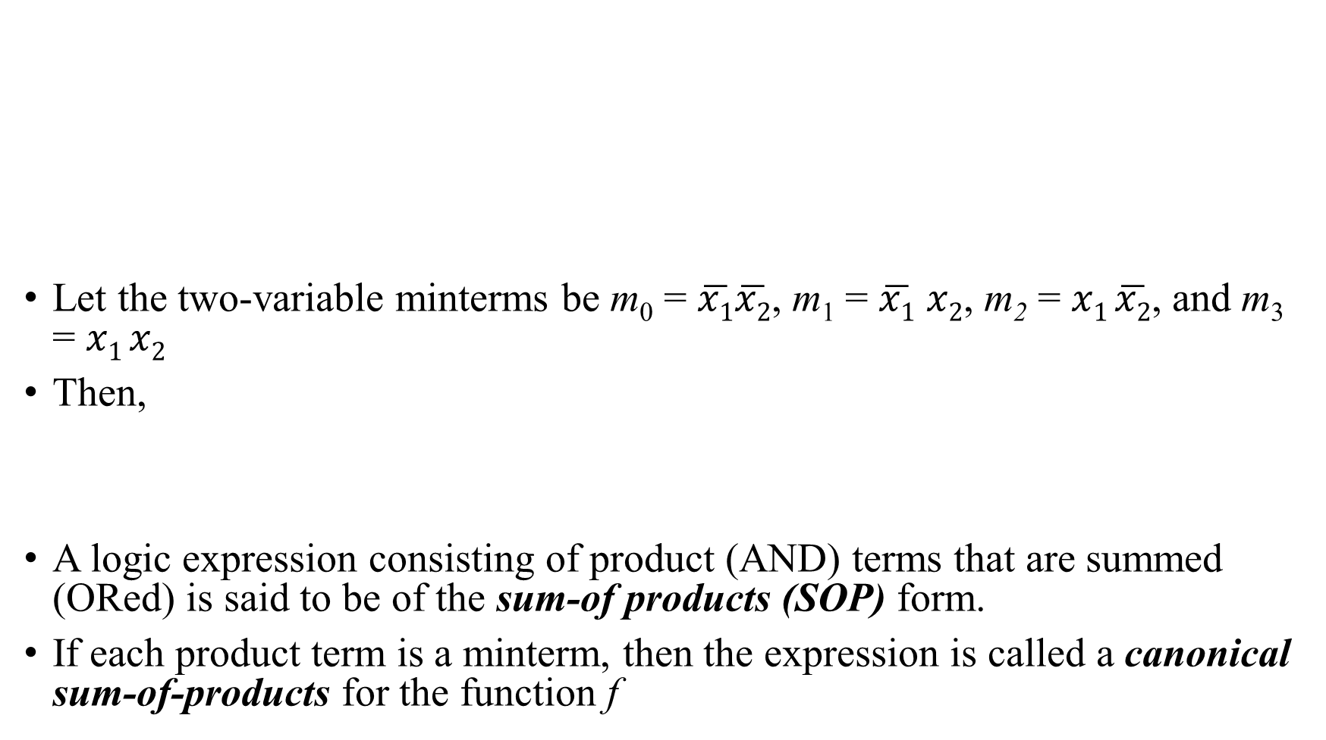
Sum-of-Products (SOP) Forms
Let the two-variable minterms be m₀ = $\overline{x1}\overline{x2}$, m₁ = $\overline{x1}$ $x2$, m₂ = $x1 \overline{x2}$, and m₃ = $x1 x2$
Then,
A logic expression consisting of product (AND) terms that are summed (ORed) is said to be of the sum-of products (SOP) form.
If each product term is a minterm, then the expression is called a canonical sum-of-products for the function f
x₁ | x₂ | Minterm | f
0 | 0 | m₀=$\overline{x1}\overline{x2}$ | 1
0 | 1 | m₁ = $\overline{x1}$x₂ | 1
1 | 0 | m₂ = x₁$\overline{x2}$ | 0
1 | 1 | m₃ = x₁x₂ | 1

Slide 13
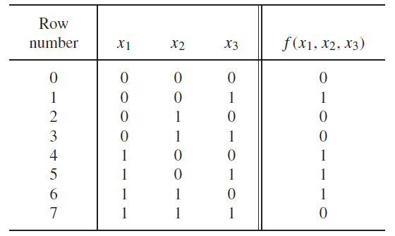


Ex. 2
Consider the above truth table
To synthesize f, we have to include the minterms m₁,m₄, m₅, and m₆
Hence,
Or simply

Slide 14
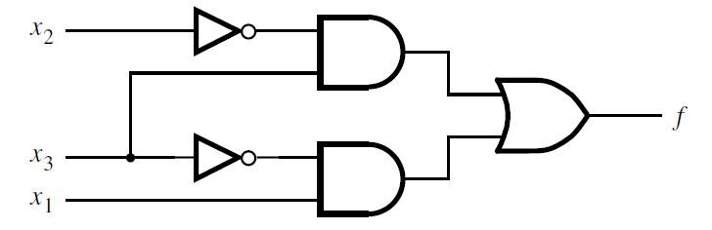

Cost of the Logical Network
Thus f can be expressed in the canonical SOP form as,
=>
A good indication of the cost of a logic circuit is the total number of gates plus the total number of inputs to all gates in the circuit.
So, here the cost is 13. In the direct canonical form it is 27.

